Slide 1
Applicant Information – AOL
Permanent Australian Resident: Yes/No
Must be ‘Yes’ for loan to proceed
Australian Passport Holders = Australian Citizen
New Zealand Passport Holder = New Zealand Citizen
Foreign Passport
Holders = Permanent Resident
TIPS
1. Always enter clients' full names as they will appear on the mortgage including middle names
2. If clients require loan documents to be issued electronically, each borrower needs a unique email address and mobile phone number.
3. For joint applicants, the second borrower will not get notified to execute the docs until the first borrower has completed theirs
3. All boxes with a red cross must be complete
Contact BDM to discuss if Country of Residency is NOT Australia.
If ‘Yes’ please ensure to provide the Country, TIN and reason the client pays tax in the table below in AOL.

Slide 2
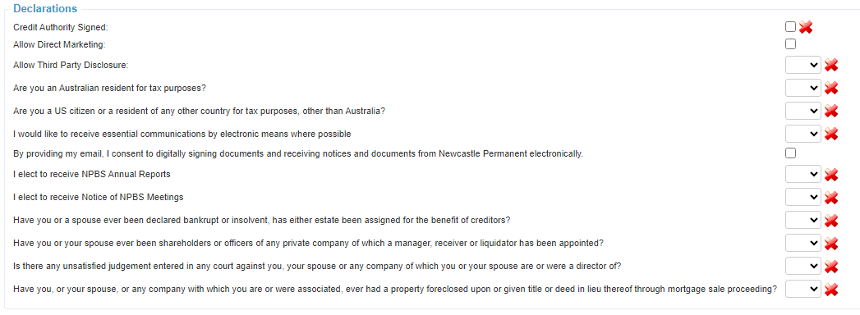
Applicant Information – AOL
Must be ‘Yes’ for loan to proceed
To receive mortgage documents electronically Essential Communications needs to be ‘Yes’ and the digitally signing documents option must be ticked.
If clients want to receive mortgage documents electronically, but would prefer other communications such statements sent by mail they can call our customer contact centre on 13 19 87 to change their preference after the loan is funded

Slide 3
Applicant Information – Client Forms
Information entered in Apply Online (AOL) populates to the Personal Information Record (PIR) form used to create a Newcastle Permanent customer number.
When the application is submitted if there are any issues with the PIR it cannot be corrected and signed again digitally, a new form must be printed and wet signed.
Newcastle Permanent Customer documents MUST be issued via AOL DocuSign. No other digital signature’s are accepted.
Using ‘Preview Forms’ in AOL to review the information in PIR prior to sending for eSign is a great way to pick up and amend any issues.
If this is ‘No’ on the PIR
Preview, check the declaration has been ticked correctly in AOL

Slide 4
Applicant Identification
The following table details the minimum identification requirements . Applicants must meet ALL the requirements of the full section 1.0, 2.0 or 3.0.
Copies of the ID should be uploaded to AOL
For F2F interviews the copies need to be signed and dated as true copies of the originals by you as their Broker, with the date in line with the date of when the loan interview took place.
Clients not interviewed F2F will receive a txt message upon validation of their personal information asking them to upload selfies with originals of the ID you have provided.
Uploading documents in the following order is preferred as gives a higher pass rate.
Clients sometimes think the text is spam. Let them know it will be coming and to action asap as their application can’t progress to pre-assessment until this is complete
1. Check the full names across all documents match and address any differences.
2. Birth extracts are not acceptable the full birth certificate is required
3. All ID provided via the client must be original. Not photos or screen shots. Digital licences are also not accepted.

